Slide 1
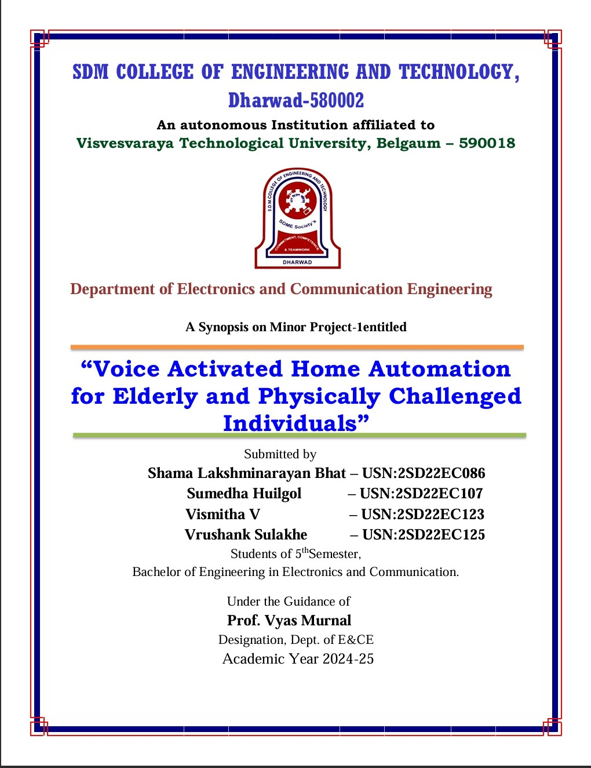

Slide 2
VOICE ACTIVATED HOME AUTOMATION SYSTEM FOR ELDERLY AND PHYSICALLY CHALENGED INDIVIDUALS.
.

Slide 3
Contents
Problem statement
Motivation
Introduction
Objective
Components used
Circuit design
Working
Result
Conclusion
References

Slide 4
Problem Statement
Elderly and disabled individuals often struggle with daily tasks due to physical and cognitive limitations.
Traditional home automation systems are challenging for them due to complex interfaces and the need for precise commands. Tasks like turning on lights, adjusting thermostats, or operating appliances can be frustrating.
The challenge is further complicated by the need for reliable internet connections and the steep learning curve of new technologies. Voice-activated home automation systems offer a solution by providing intuitive, hands-free control. However, to truly benefit these users, these systems must prioritize accessibility and ease of use.

Slide 5
Motivation
As the global population ages and the number of individuals with physical disabilities increases, there is a growing need for solutions that promote independent living and enhance the quality of life for elderly and physically challenged people. Many of these individuals face physical or cognitive challenges that make daily tasks difficult.

Slide 6
Introduction
Convenience: Control home lights and temperature using voice commands.
Revolutionary Technology: Changes how we interact with our living spaces.
Benefits: Enhances daily life by making it more convenient, efficient, and secure.
Potential: Transforming homes into intelligent, responsive environments.

Slide 7
Objectives
Accessibility: Intuitive interface eliminates the need for physical interaction, b enefiting individuals with mobility impairments.
Independence: Enables control of home appliances, lighting, and security syst ems through voice commands, fostering greater autonomy and allowing daily t asks without assistance.
Customization: Tailors to specific user needs, allowing creation of personalized routines and preferences aligned with daily schedules and health.

Slide 8
Components Used
ESP32 Micro-Controller
Relay driver
L289N Motor driver
LED Bulb
Fan
9 Volt Battery

Slide 9
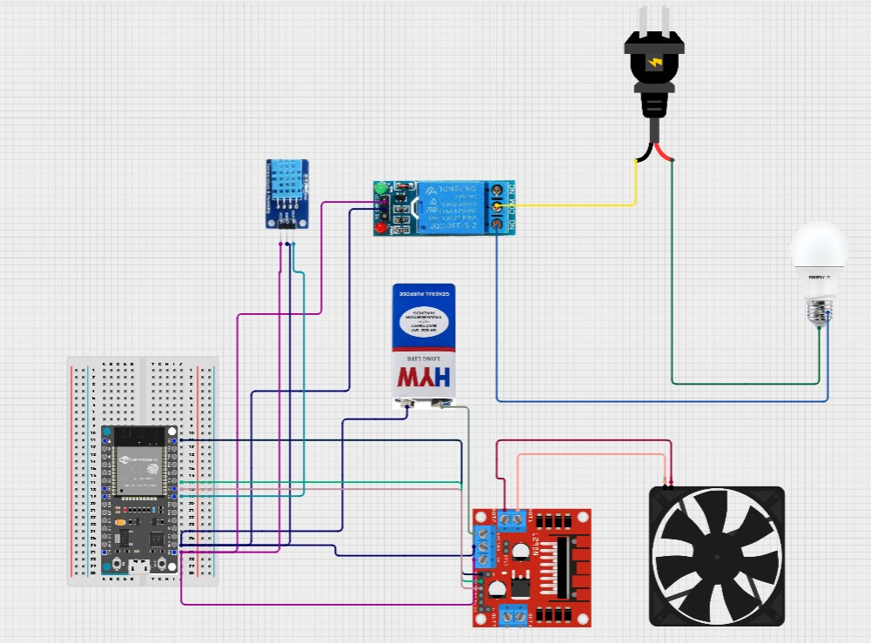
Circuit design

Slide 10
Working
This project effectively showcases a voice-activated home automation system capable of managing two key components: a light and a fan. By issuing straightforward commands such as "Turn on the light" or "Turn off the light," users can seamlessly control the lighting. The fan is equally easy to manage with voice instructions like "Turn on the fan" or "Turn off the fan." An added feature, the "Auto-fan control," adjusts the fan's speed based on the ambient temperature, enhancing comfort and energy efficiency. This system is designed to be user-friendly and highly responsive, offering a smart, convenient solution for home automation.

Slide 11
Result
Speed control :As our fan is voice activated .The speed of fan is varying according to external temperature and humidity using sensors. And if outside temperature is less, speed of fan is slow. Similarly if the external temperature is high or moderate, the fan speed will be high or moderate respectively. For doing above operations DTH11 sensors , which is digital sensor that measures temperature and humidity are used.
Light control : The main component in this project is light. and light is controlled using voice ,like switching on and off of light is done by giving voice commands.

Slide 12
Conclusion
Voice-activated home automation can greatly enhance the lives of elderly and physically challenged individuals, offering increased independence, convenience, and safety through simple voice commands. However, challenges like accuracy issues, privacy concerns, internet dependency, and complexity must be addressed. By focusing on user-friendly design, robust privacy measures, and adequate training, these systems can promote autonomy and improve daily life. Ongoing development is crucial to meet the diverse needs of users.

Slide 13
References
https://www.copilot.com
www.arduino.cc
https://sist.sathyabama.ac.in
www.cirkitstudio.com
www.esp32io.com
http://homeautomationmagzine.com

Slide 14
Thank You

Slide 15
Cost for components
ESP32 Micro-Controller – Rs.600
Relay driver – Rs.80
L289N Motor driver- Rs.150
LED Bulb- Rs.40
Fan- Rs.190
9 Volt Battery- Rs.30
TOTAL COST - Rs.1090

